Slide 1
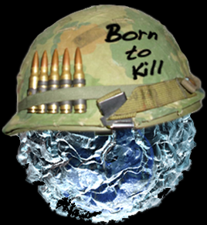
Psychoneuroimmunology

Slide 2
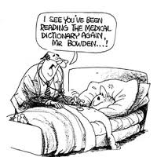
Are symptoms always real?
Medical Student Syndrome: is a condition frequently reported in medical students, who perceive themselves or others to be experiencing the symptoms of the disease(s) they are studying
Mass psychogenic illness…
Stress is not helpful, but seeking advice is always important

Slide 3
Introduction to PNI
Psychoneuroimmunology (PNI) is an in interdisciplinary field concerned with the relationships between the nervous system and immune system, and the impact of these relationships on disease.
Psycho = psychosocial processes
Neuro = nervous system processes
Immunology = immune system processes

Slide 4
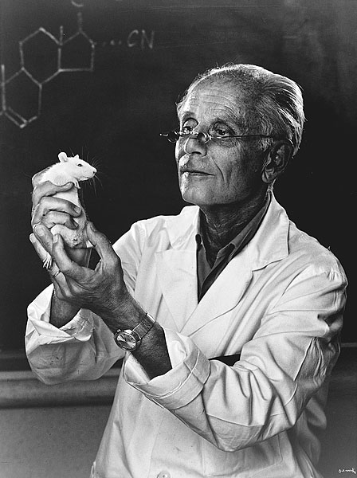
Historical Foundations
Hans Selye – Hungarian endocrinologist who stumbled upon the effects of stress on the body in his experiments with rats
Was studying the effects of a new ovarian hormone, when he discovered consistent physiological changes in the rats...

Slide 5
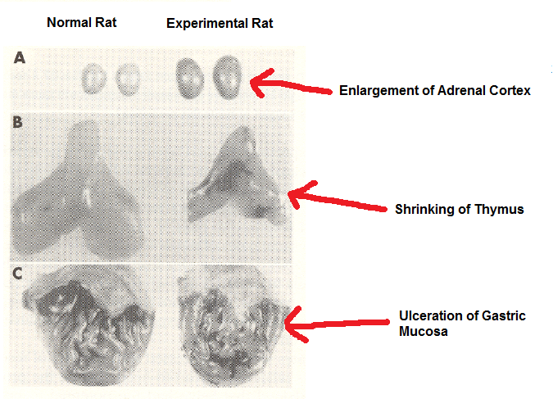

Slide 6
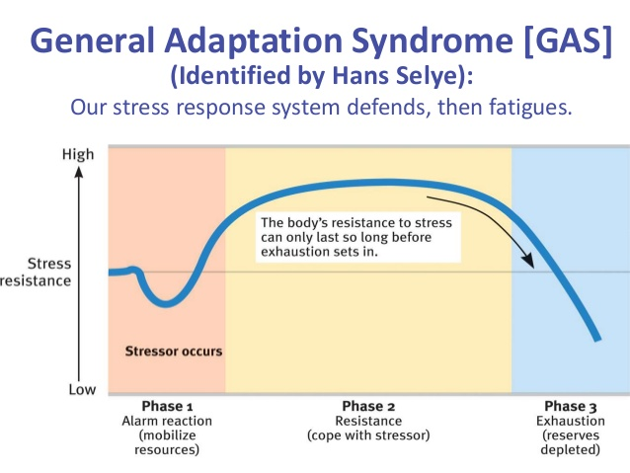
Selye’s definition of stress:
A non-specific response of the body to demands made upon it.

Slide 7
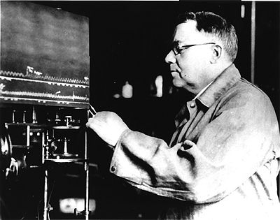
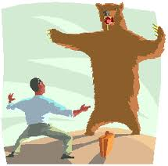
Historical Foundations
Hans Selye credited physiologist Walter Cannon for laying groundwork for his discovery
Cannon described:
Homeostasis
Fight or Flight Response

Slide 8
Historical Foundations
The emergence of the field of psychoneuroimmunology is often credited to Robert Ader (psychologist) and Nicholas Cohen (immunologist) – who used behavioural models to understand disease progression (in rodents).
  Standard classical conditioning experiment
  Immunosuppressive drug (UCS)→ immune suppression (UCR)
  Immunosuppressive drug + saccharin (NS initially) → immune suppression (UCR)
  Saccharin (CS) → Immune Suppression (CR)
Later others demonstrated that activating immune function was possible
  Overview - Ader, R., & Cohen, N. (1985). CNS–immune system interactions: Conditioning phenomena. Behavioral and Brain Sciences, 8(3), 379-395. doi:10.1017/S0140525X00000765
    https://www.cambridge.org/core/journals/behavioral-and-brain-sciences/article/cnsimmune-system-interactions-conditioning-phenomena/9EDBFDAE6E36CB4B96B1DD353C5963AB

Slide 9
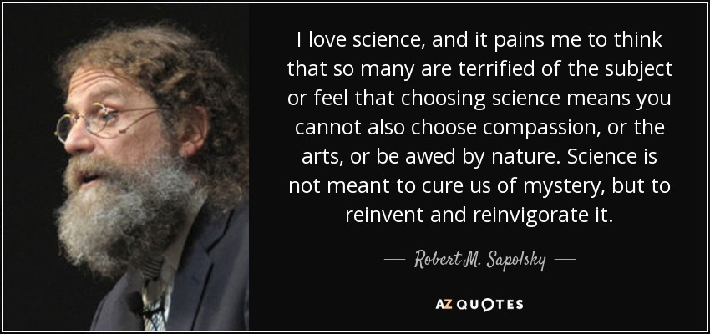
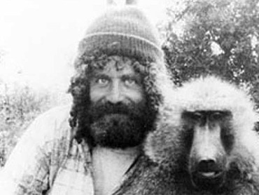
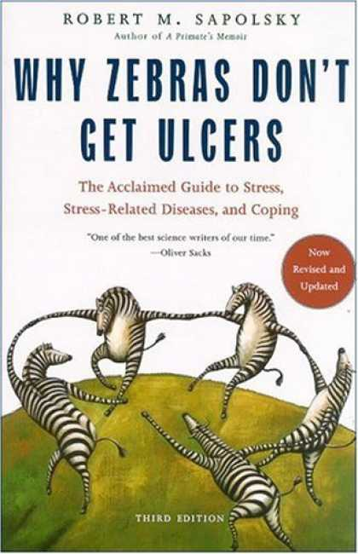

PNI – an emerging field
Mark Twain “ I am and old man and have known a great many troubles, but most of them never happened.”
William James “The greatest weapon against stress is our ability to choose one thought over another.”

Slide 10
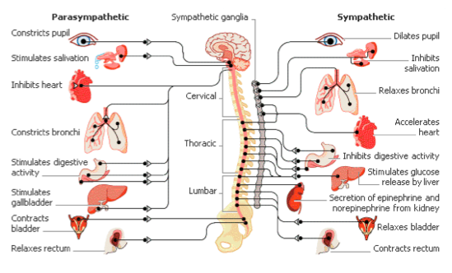
Physiology Review: Fight or Flight

Slide 11
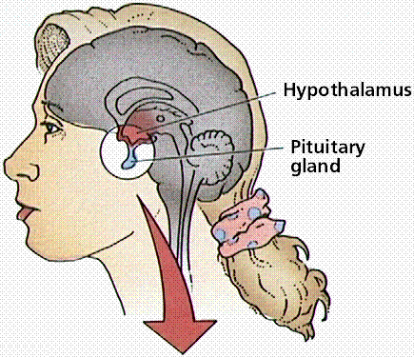
Physiology Review: Fight or Flight
Systems activated during stress:
Neuroendocrine System → HPA Axis (hypothalamic pituitary axis)
Sympathetic Nervous System → SAM Axis
(sympathetic adrenal medullary axis)

Slide 12
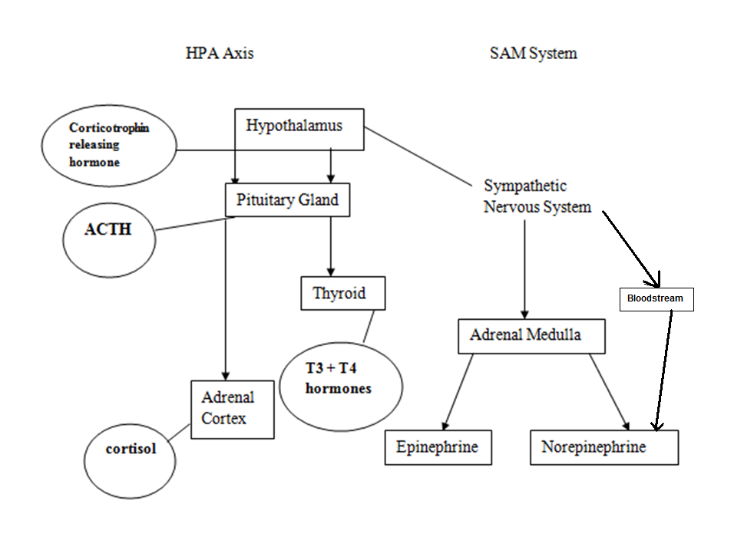

Slide 13
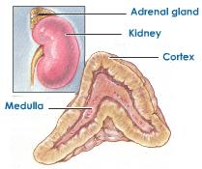
Latin to help memorise...
Ad = near/next to
Renal = Kidney
Cortex = Bark (tree)
Medulla = Marrow
HPA Axis → Adrenal Cortex
  Releases glucocorticoids (GC)
SAM Axis → Adrenal Medulla
  Releases epinephrine, norepinephrine

Slide 14
Stress Hormones
Cortisol
  Released by the Adrenal Cortex
  Function: increases blood sugar (gluconeogenesis), divert energy to exercising muscle, enhance cardiovascular tone
  Binds to receptors of fat cells, liver, pancreas
  Suppresses digestion, growth, reproduction, immune system
Epinephrine (also known as Adrenaline)
  Released by the Adrenal Medulla
  Function: vasoconstriction (increased blood pressure), increase heart rate (binds primarily to heart cells)
  Decreases digestive and immune functions

Slide 15
Stress Hormones
Norepinephrine (also known as Noradrenaline)
  Released from the Adrenal Medulla
  constitutes only 20% of the catecholamines (hormones) secreted from the Adrenal Medulla
  Already prevalent in the bloodstream – released by the sympathetic nerves
  Function: increases heart rate, release glucose to skeletal muscles

Slide 16
Effects of stress
Digestion
  Less saliva is being produced, small intestine stops functioning, large intestine empties (lighter to flee this way)
Growth
  Growth hormones deplete during stress, and can stop growth in extreme circumstances (stress dwarfism in children)
  Can have a negative impact on bone density in adults
Reproduction
  Reproductive hormones diminish – can lead to amenorrhea
Immune Function
  Cortisol can lead to a decrease in lymphocytes – increase susceptibility to illness

Slide 17
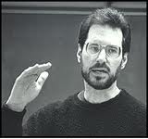
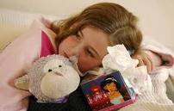
Stress and the common cold
Sheldon Cohen teamed up with David Tyrell in the Common Cold Unit in England to study the relationship between stress and development of the common cold.
Experiment:
  400 healthy volunteers inoculated with cold viruses, quarantine them in apartments (1-3 people), and monitor closely for infection and illness
Results published in NEJM
  https://www.nejm.org/doi/full/10.1056/NEJM199108293250903

Slide 18
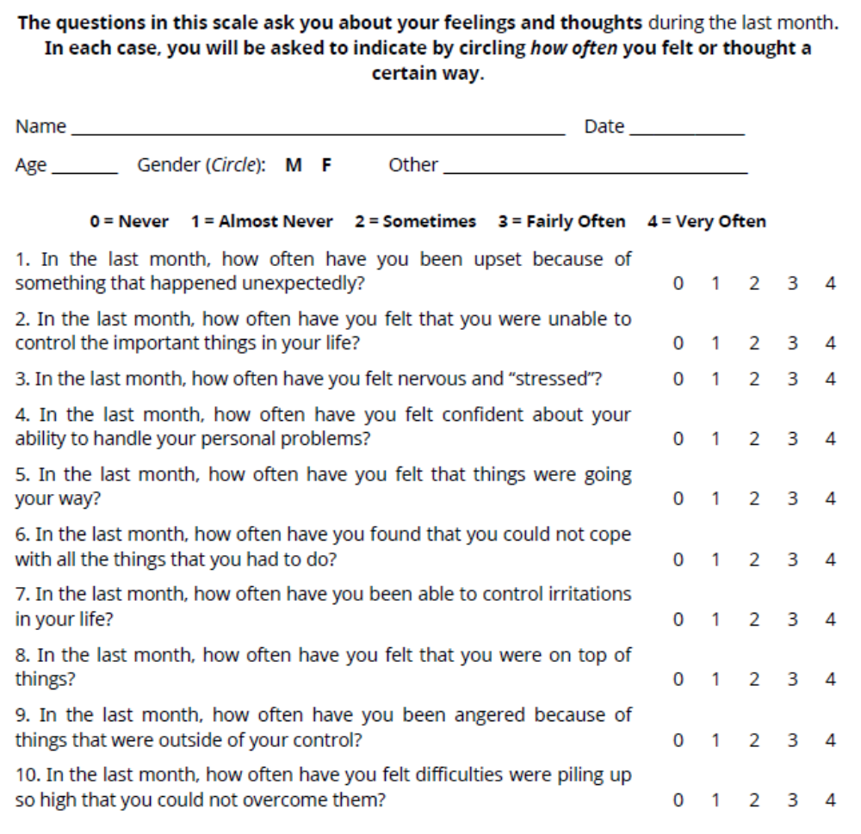

Slide 19
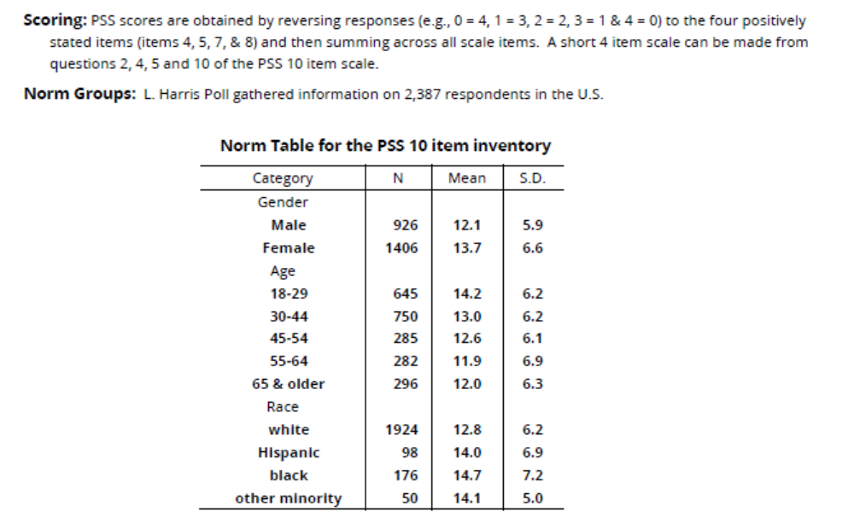
Score…
https://www.northottawawellnessfoundation.org/wp-content/uploads/2018/04/PerceivedStressScale.pdf

Slide 20
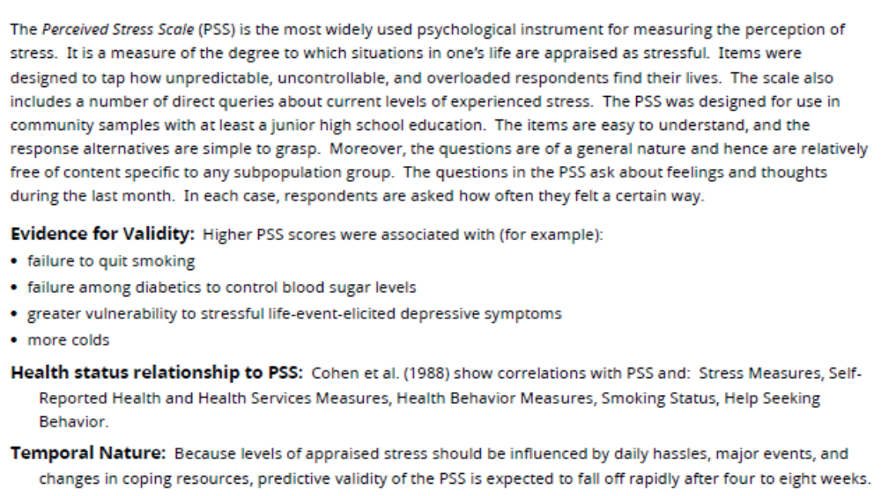

Slide 21
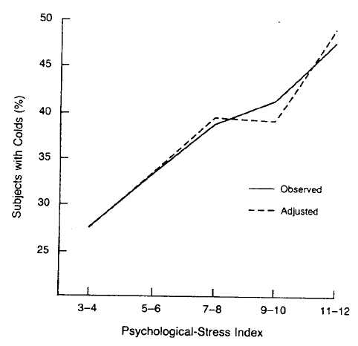
Stress and the common cold

Slide 22
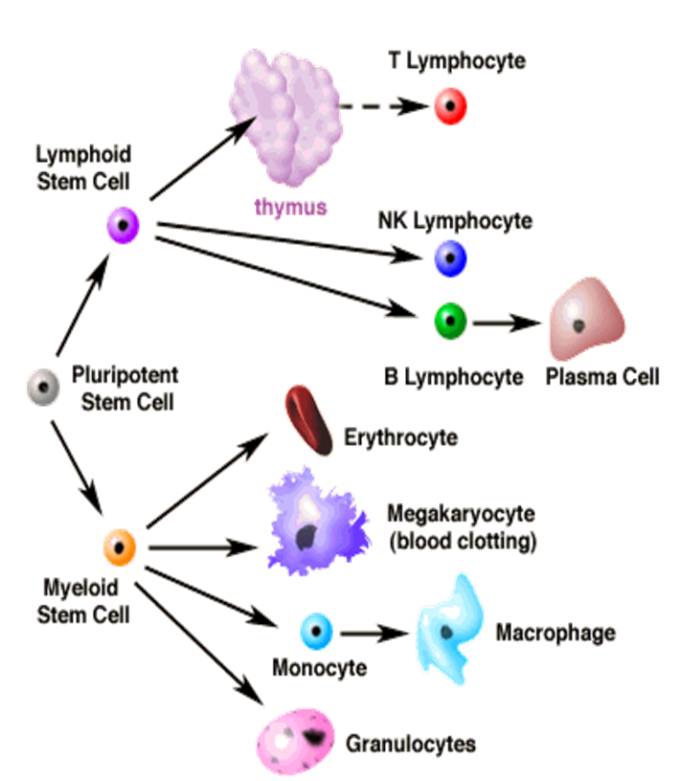
Stress and immunity
T cells (mature in thymus):
Includes T helper cells, T suppressor cells, cytotoxic T cells
Macrophages:
“big eaters”
Natural Killer Cells (NK):
major role in fighting tumours and viruses
B cells (mature in bone marrow):
- Develop into plasma cells (which are a source of antibodies – Y-shaped proteins that identify and neutralise foreign objects)

Slide 23
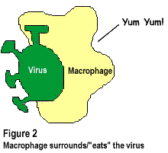
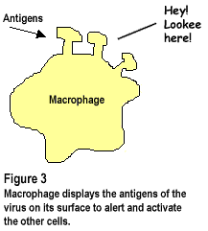
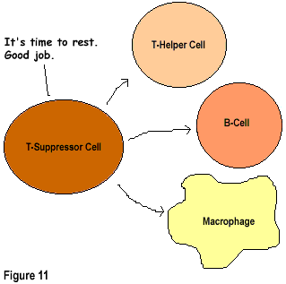
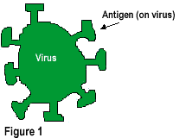
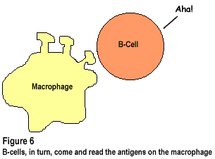
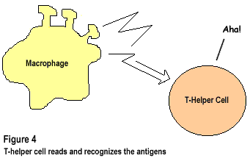
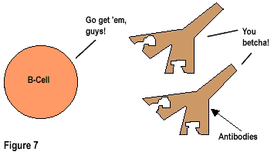
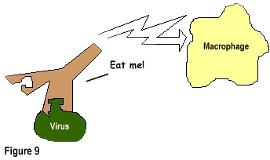
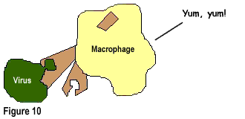

Slide 24
Stress and immunity
Acute/Intermittent stress (e.g., bouts of exercise) - actually associated with enhanced immune responses (e.g., reception of vaccine)
Chronic stress, however, may lead to immune dysregulation - underexpression or overexpression of immune molecules
So, occasional stress is good, chronic isn’t.

Slide 25
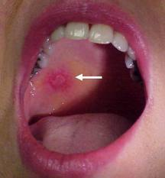
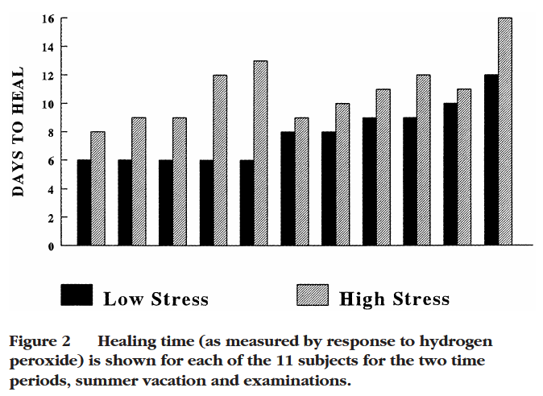
Stress and immunity research
Wound Healing Example 1: Dental Student Study
two punch biopsies in 11 dental students – during examination stress and while they were on vacation
Measured healing with: (1) daily photographs, (2) foaming response to hydrogen peroxide (antiseptic) – it reacts with catalase from blood and damaged cells
Results:
Wounds took 3 days (40%) longer to heal on average – and no student healed as quickly as they did while they were on holiday.
Interleukin cytokine production decreased 68% during exam time as well.

Slide 26
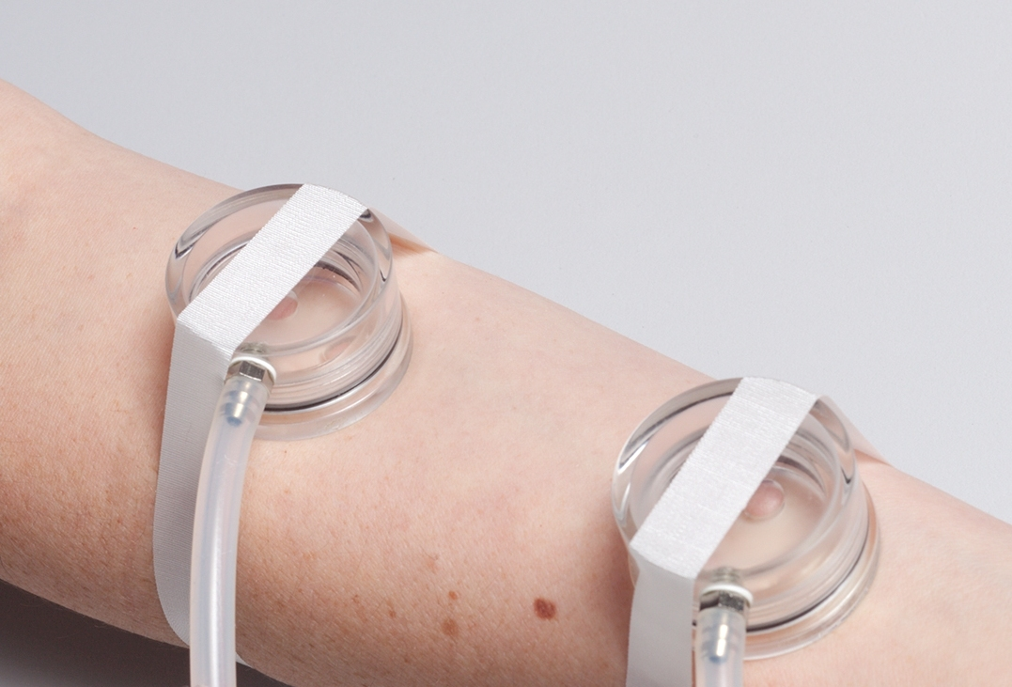
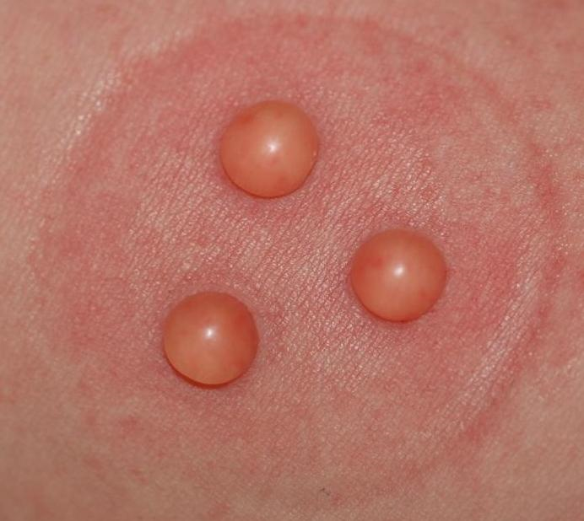
Stress and immunity research
Wound Healing Example 2: Interpersonal Stress
42 healthy married couples admitted twice to a hospital research unit for 24 hours
Visit 1: social support task
Visit 2: discussion of marital disagreements
  Interactions assessed by coding positive and negative behaviours
Suction blisters were given to participants at each visit and wound healing assessed on follow-up via:
  transepidermal water loss
Hostile couples (more negative across both visits) – wounds healed on average 75% more slowly than less hostile couples...

Slide 27
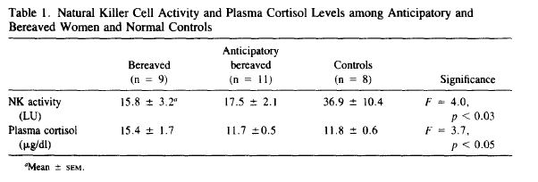
Stress and immunity research
Cortisol and NK cell activity during bereavement (Irwin et al., 1988)
https://www.sciencedirect.com/science/article/pii/0006322388902727
Reduced NK cell activity not entirely explained by plasma cortisol levels

Slide 28
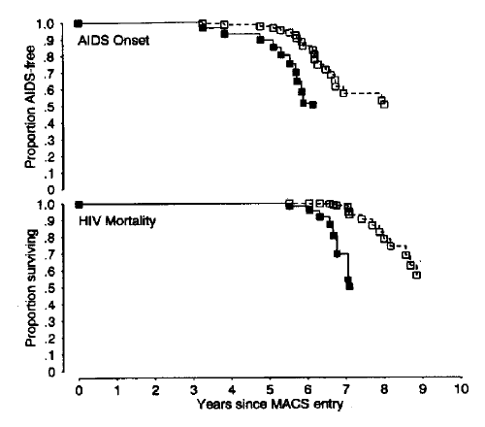
Stress and immunity research
Accelerated HIV progression in rejection-sensitive gay men
(Cole, Kemeny, & Taylor, 1997)
9-year prospective study following 72 initially healthy HIV positive gay men
Rejection-sensitive individuals had:
  Acceleration in appearance of critically low T-lymphocyte level
  Acceleration to AIDS diagnosis and death

Slide 29
Stress and immunity models
A complex aspect of studying stress and immune function is that studies often report contradicting results in terms of immune molecule function.
  Some studies report an association between stress and immune suppression (such as the ones previously discussed), but stress has also been found to exacerbate inflammatory diseases (e.g., multiple sclerosis, arthritis, Crohn’s disease)
Immunosuppression Model
vs.
Glucocorticoid Resistance Model

Slide 30
Immunosuppression model
Stress can downregulate immune function via:
Activation of autonomic nervous system fibres that descend from the brain to lymphoid organs (e.g., thymus, spleen)
Triggering of hormone secretion that bind to white blood cells and alter their function
More complex - induction of immunomodulatory coping behaviours (e.g., cigarette smoking, heavy alcohol consumption, etc.)
Strengths: good at explaining the relationship between stress, and infectious diseases, some cancers (tumours), wound healing
Weaknesses: does not explain how stress influences diseases where inflammation is a key feature
see also Miller et al. (2002) - link

Slide 31
Glucocorticoid-resistance model
According to the GRM, chronic stress diminishes the immune system’s sensitivity to glucocorticoid hormones that normally terminate the inflammatory cascade
  (For acute stress, cortisol has anti-inflammatory properties)
When there are chronically elevated levels of glucocorticoids (e.g., cortisol), lymphocytes downregulate receptors of glucocorticoid hormones (and cortisol can no longer do its anti-inflammatory job!)
Inflammation results

Slide 32
Stress and immunity
Overall, the literature suggests that chronic stress can lead to immune dysregulation in the following ways:
  Induction of chronic low-grade inflammation
    Chronic low-grade inflammation has been found among depressed and chronically stressed individuals
  Delayed wound healing
  Increased susceptibility to upper-respiratory infections
    Common Cold Unit study, over 13 months dementia caregivers report more upper-respiratory infections
  Weakened vaccine responses
    E.g., dementia caregivers and influenza vaccine
  Disrupted immune control of latent viruses
    Herpes recurrence in stressed individuals
  Impair immune system’s response to anti-inflammatory signals.

Slide 33
Allostasis and allostatic load
McEwen & Seeman (1999) https://nyaspubs.onlinelibrary.wiley.com/doi/pdfdirect/10.1111/j.1749-6632.1999.tb08103.x
There has been a movement away from ‘fight or flight’ models of stress in the last decade – and now the physiological and health effects of stress are discussed in terms of allostasis and allostatic load.
Allostasis – process of achieving stability (homeostasis), a result of responding to our environment
Allostatic Load (AL) – the cumulative biological wear and tear that result from excessive cycles of response

Slide 34
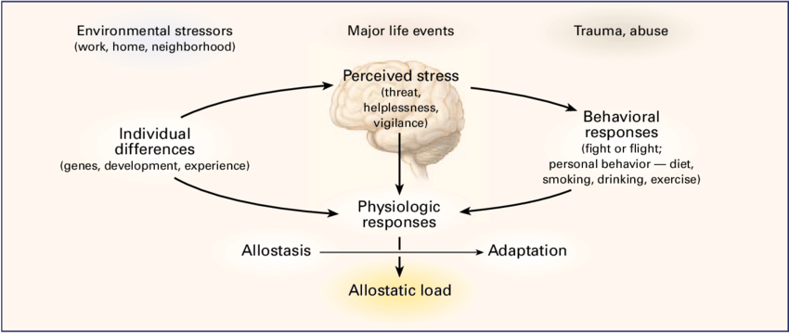
Mechanisms in allostatic load
Real or perceived threats initiate SAM and HPA responses… (brain’s evaluation [appraisal?] important)
Why does allostatic load develop?
  Four possible mechanisms:
Repeated hits from multiple stressors
Lack of adaptation
Prolonged response due to delayed inhibitory functioning
Inadequate response

Slide 35
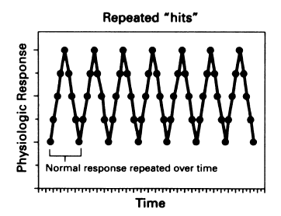
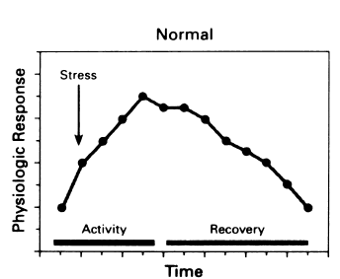
Mechanism 1: Repeated ‘hits’
e.g. increased risk of cardiovascular disease from constant occupational noise exposure. Illustrations from McEwen & Giaronos (2011).

Slide 36
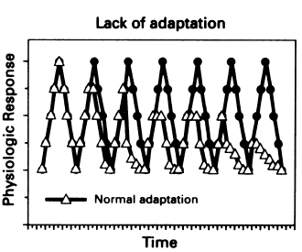
Mechanism 2: Lack of adaptation
First described in repeated public speaking challenge – subset of individuals failed to habituate their cortisol response.

Slide 37
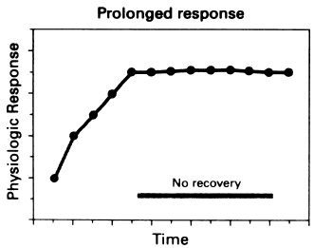
Mechanism 3: Prolonged response
Body loses its effectiveness in turning off the stress response (e.g. after damage to hippocampal region).

Slide 38
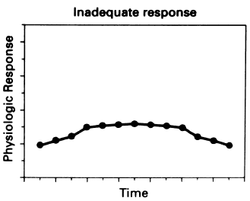
Mechanism 4: Inadequate response
Cortisol not being produced during chronic stress, sometimes leading to an overactive immune system through other pro-inflammatory processes (Miller et al., 2002).

Slide 39
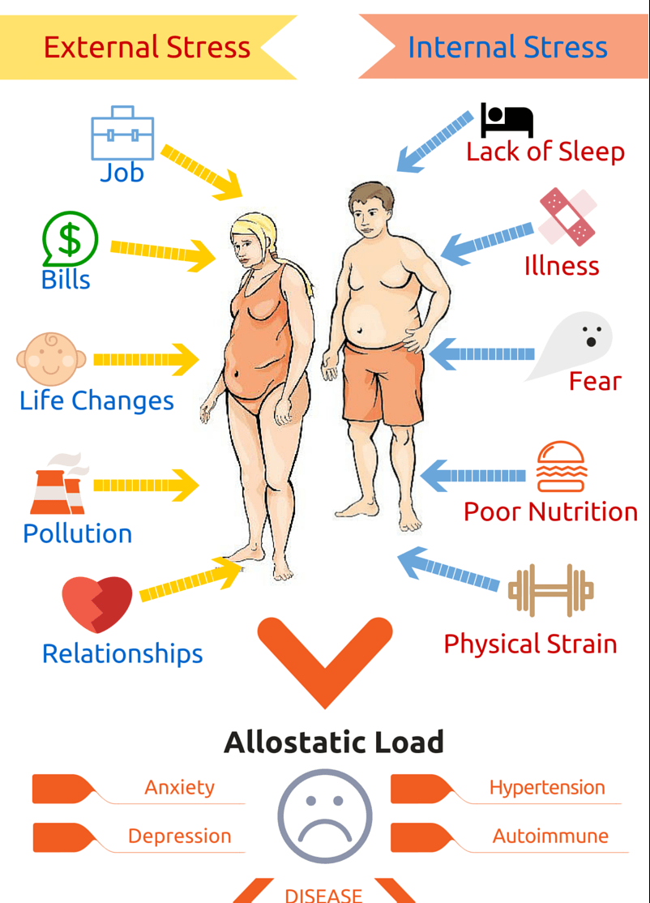
Allostatic processes
Mediators of Allostasis: cortisol, epinephrine, norepinephrine
Primary Effects: cellular events, impact on protein transcription, etc.
Secondary Outcomes: effects on organs and tissues (e.g., hypertension, common cold)
Tertiary Outcomes: diseases or disorders (e.g., cardiovascular disease, severe cognitive decline)

Slide 40
Biomarkers of allostatic load
Neuroendocrine Biomarker Examples:
  Cortisol, epinephrine, norepinephrine, dopamine (neurotransmitter involved in many neurological activities, also increases bp and hr)
Immune Biomarker Examples:
  Interleukin-6 (cytokine), tumour necrosis factor alpha (cytokine involved in tumour apoptosis)
Metabolic Biomarker Examples:
  High density lipoprotein cholesterol (HDL), low density lipoprotein cholesterol (LDL), glucose, insulin
Cardiovascular and Respiratory Examples:
  Blood pressure, heart rate
Anthropometric Biomarker Examples:
  Waist-to-hip ratio, BMI
See also Juster et al. (2010)

Slide 41
The importance of cortisol
  Linked to a variety of health outcomes – cardiovascular disease, poor cognitive functioning, fractures, functional disability, obesity, type-II diabetes, autoimmune diseases, mortality
The challenge of studying cortisol – it follows a diurnal pattern naturally – highest cortisol production occurs in the second half of the night with peak cortisol levels in the early morning hours

Slide 42
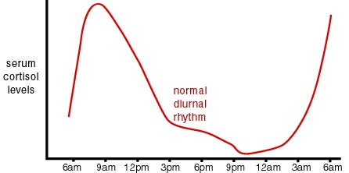
Diurnal pattern of cortisol

Slide 43
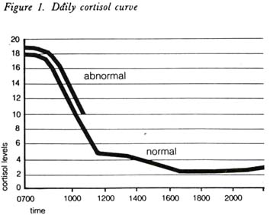
The Cortisol Awakening Response
An allostatic biomarker, the cortisol awakening response (CAR) is defined as the brisk increase of cortisol levels within 30 min of awakening in the morning
  Considered a sensitive indicator of the function of the HPA axis
  Increased CAR is associated with:
    Chronic stress and worrying
    Social stress and lack of social recognition
Function of CAR – unknown, perhaps associated with daily demands, neural activity

Slide 44
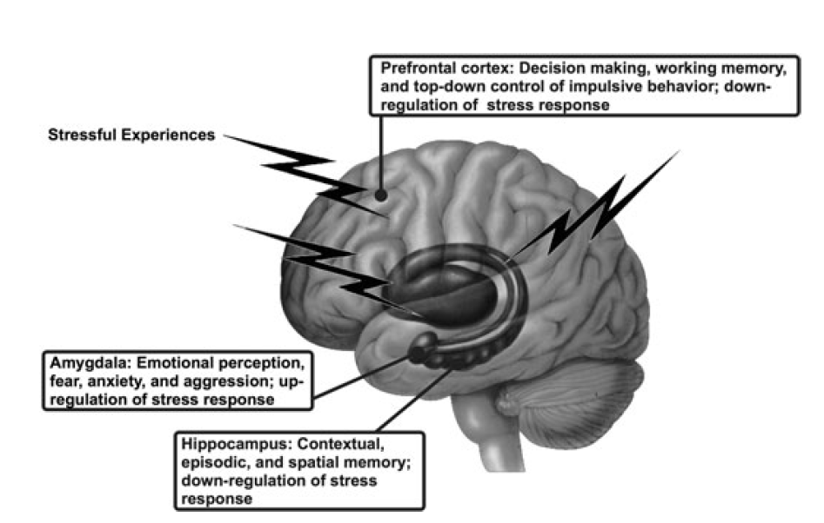
Stress and the brain
Three main brain areas involved in the stress response:

Slide 45
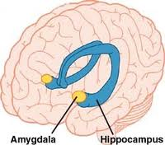
Brain structures and function
Amygdala
Essential for fearful and emotionally laden events (involved in anything unexpected or uncertain)
Sends messages to hypothalamus – initiates stress response
Amygdala volume correlates with social network size (more friends = bigger amygdala) (Bickart et al., 2011)

Slide 46
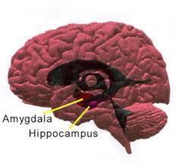
Brain structures and function
Hippocampus
Two main roles:
  1. Spatial learning and memory
    Supports the amygdala in determining context in which emotionally-laden events take place, as well as other aspects of episodic and declarative memory
    Also plays an important role in consolidation of information from short-term memory to long-term memory
  2. Negative feedback regulation of HPA Axis
    cortisol returns to hypothalamus and pituitary gland – and inhibits stress response
Hippocampus - one of the most sensitive and malleable regions of the brain

Slide 47
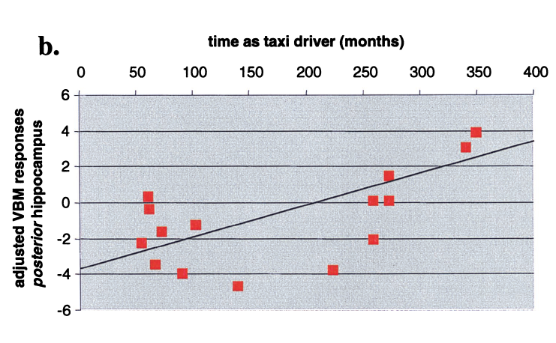
Brain structures and function
Hippocampus
the structure of the hippocampus is sensitive to environmental demands
  Taxi Driver study (Maguire et al., 2000)
    Licensed London taxi drivers were compared to control subjects
    Hippocampal volume correlated with time spent as a taxi driver
Voxel based morphometry ☺

Slide 48
Stress and the brain
Effects on the hippocampus
Repeated stress has been linked to remodelling of hippocampal circuitry – the shortening of dendrites, loss of spine synapses, suppression of neurogenesis
Permanent damage to the hippocampus could:
Impair hippocampal involvement in episodic, declarative, contextual, and spatial memory
Impair hippocampus in regulating HPA activity (impairs the ability of the hippocampus to terminate stress response)

Slide 49
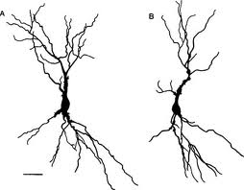
Stress and the brain
Glucocorticoid Cascade Hypothesis of Hippocampal Aging
Theory states: excess glucocorticoids (GC) damage the brain (Sapolsky et al., 1986) and can lead to ‘unsuccessful aging’
Excess GC → atrophy of hippocampus dendrites
Overexposure to GC → permanent loss of hippocampal neurons

Slide 50

Brain structures and function
Prefrontal cortex
Involved in higher cognitive functioning:
  Working memory
  Executive control
Threat-related responding and coping
Orbital and dorsal medial frontal cortex communication directly with the hypothalamus in regulating stress response axes.

Slide 51
Stress and the brain
Effects of stress on the prefrontal cortex
Acute stress can reduce working memory performance (Del Arco et al., 2007)
Psychosocial stress can impair attentional control (Liston et al., 2009)
Dendritic spine loss (in rats) (Radley et al., 2006)

Slide 52


Stress and social hierarchies
Sapolsky’s Baboons
  Prolonged stress (low on social hierarchy) effects: Hypertension, increased vulnerability to atherogenic effects of high-fat diet
Whitehall Study (1967)
  18,000 men in British Civil Service
  Showed a steep inverse association between social class (grade of employment) and mortality from a wide range of diseases

Slide 53
Stress and cancer
Growing evidence…
Possible mechanisms:
  Diminished activity/responsiveness of NK cells
  Alterations in DNA repair and apoptosis (programmed cell death)
More likely that stress impacts the progression and reoccurrence of cancer, rather than the incidence

Slide 54
https://journals.sagepub.com/doi/pdf/10.1177/1559827610395467

